Slide 1

百问网LVGL(v8)课程
1-2-1 Windows PC模拟器(Code::Block)运行LVGL
讲师：biubiu
韦东山·监制
http://www.codeblocks.org

Slide 2
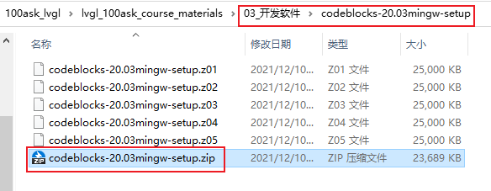

安装Code::Block
Code::Block在资料中 “03_开发软件/codeblocks-20.03mingw-setup”，选中“codeblocks-20.03mingw-setup.zip”右键进行解压分卷包：
解压后，双击“codeblocks-20.03mingw-setup.exe”安装Code::Block：
http://www.codeblocks.org

Slide 3
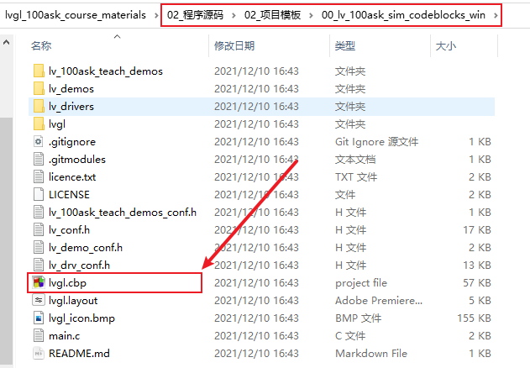
Code::Block运行LVGL
成功安装了 Code::Block 之后，进入下面这个目录双击 “lvgl.cbp” 打开项目：
http://www.codeblocks.org

Slide 4
感谢观看
祝学习顺利
http://www.codeblocks.org

